Slide 1
SAP HANA
Lesson Name: Core Data Services
Notes:
Add instructor notes here.

Slide 2
Lesson Objectives
After completing this lesson, participants will be able to –
Basics of Core Data Services (CDS)
Demo on CDS
CDS view Definition Features
Notes:
Add instructor notes here.

Slide 3
Contents
Introduction to CDS
CDS in ABAP
Demo on CDS
CDS View Definition Features

Slide 4
Introduction to Core Data Services (CDS) View
CDS stands for Core Data Services.
A view is an entity that is not persistent; it is defined as the projection of other entities.
CDS View is reusable data models on the database.
It is a data model that represents framework of what relationships are in a database.
To take advantage of SAP HANA for application development, SAP introduced a new data modeling infrastructure known as core data services.
With CDS, data models are defined and consumed on the database rather than on the application server.
The rule-of-thumb is simple:
Do as much as you can in the database to get the best performance.

Slide 5
Introduction to Core Data Services (CDS) View
A CDS view is defined for existing database tables and any other views or CDS views in ABAP Dictionary .
CDS is a data modeling infrastructure for defining and consuming semantic and reusable data models on the database, rather than on the ABAP server, regardless of the database system used
Technically, it is an enhancement of SQL which provides you with a data definition language (DDL) for defining semantically rich database tables/views (CDS entities) and user-defined types in the database.
CDS entities and their metadata are extensible into the ABAP Data Dictionary and the ABAP language.

Slide 6
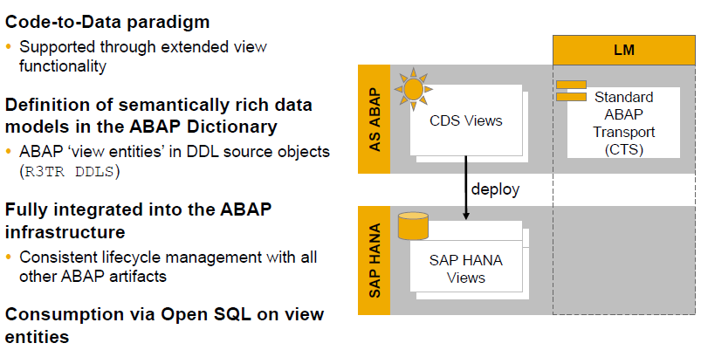
Features of Core Data Services (CDS) View

Slide 7
Advantages of CDS
Semantically rich data models
CDS builds on the well-known entity relationship model and is declarative in nature, very close to conceptual thinking.
Compatibility across any database platform
CDS is generated into managed Open SQL views and is natively integrated into the SAP HANA layer.
Efficiency
CDS offers a variety of highly efficient built-in functions — such as SQL operators, aggregations, and expressions — for creating views.
Extensibility
Customers can extend SAP-defined CDS views with fields that can be automatically added to the CDS view

Slide 8
Definition of CDS VIEW
The statement DEFINE VIEW is used to create the CDS DDL in ABAP.
This is done in the CDS source code of a CDS data definition in the ABAP Development Tools (ADT)
Definition is only possible with ABAP Development Tools in Eclipse/HANA
Studio .
CDS view cannot be created via transaction SE11.
CDS views can be developed and maintained in SAP HANA studio and in ABAP in Eclipse

Slide 9
CDS View Definition
Definition of the CDS consists of
View name
Semantic information (key field)
Projection List
Aliases
Projection List :
Client Dependency
Semantic Information (Key)
Aliases
Aggregation
Literals
Arithmetic Expressions
Conditional Expressions

Slide 10
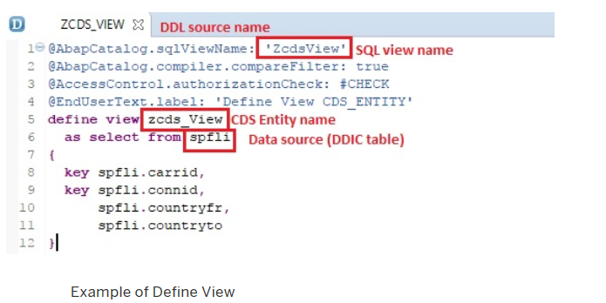
Simple CDS View

Slide 11
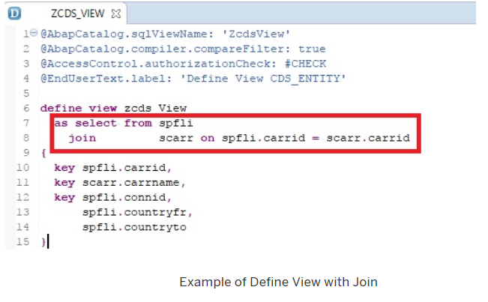
CDS View with Join

Slide 12
Demo
Create Simple CDS View, Preview it and consume it via Open SQL

Slide 13
CDS View Definition
Literal values:
C-sequence literals (Max length: 1333 )
Signed integer literals (4-Byte)
Aggregation functions:
MIN, MAX, COUNT, AVG, SUM
Alias required for function results
String functions:
LPAD,SCORE,LEFT,LTRIM,SUBSTRING
Alias required for function results

Slide 14
Type of CDS Views
CDS View with Input Parameters
CDS View Extensions
View-on-View
CDS View without Input Parameters

Slide 15
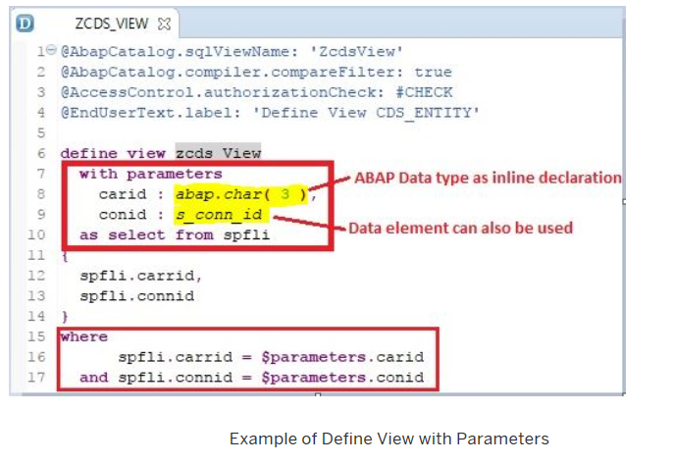
Type of CDS Views
CDS View with input parameters
To create Views with parameters key word used is With PARAMETER.
Comma-separated list of scalar input parameters and their corresponding type is to be mentioned.
Supported parameter types are as follows:
Predefined data type like abap.char(char_len)
Name of a data element

Slide 16
Demo
CDS View with Input Parameter

Slide 17
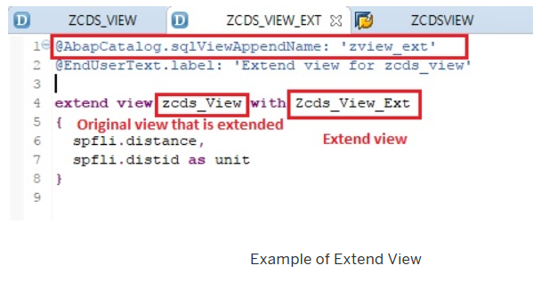
Type of CDS Views
CDS View Extensions
A CDS view can be extended by adding new fields .
To extend a CDS Base view, the key word used is EXTEND VIEW .
In the extended view, mention the new fields to be added separated by comma.

Slide 18
Demo
Create Base CDS View
Extend the above CDS View

Slide 19
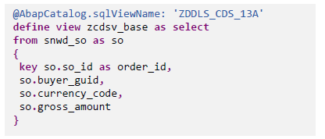
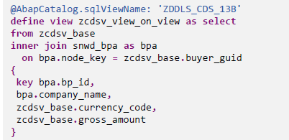
Type of CDS Views
View-on-View
Another important type of CDS view is View on View.
You can create CDS view on another CDS View(called as the Base View).
There is no restriction on the number of layers.

Slide 20
Demo
Create Base CDS View
Create View on the above Base View

Slide 21
Consumption of CDS View
Consumption of CDS can be done in the following ways:
In a CDS View
By Open SQL
Data Preview (context menu in ADT)
SAP List Viewer
SAP NetWeaver Gateway (OData Model)

Slide 22
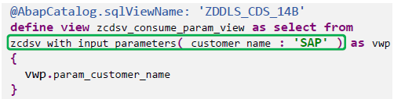
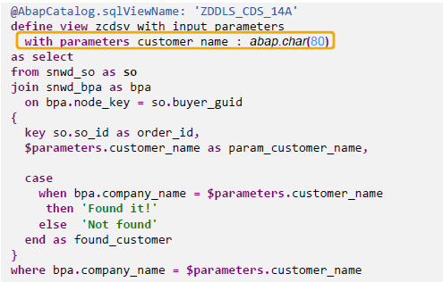
Consumption of CDS View
Consumption of CDS View in CDS View:
You can create CDS view on another CDS View(called as the Base View)
View on View is nothing but the consumption of CDS View in another View

Slide 23
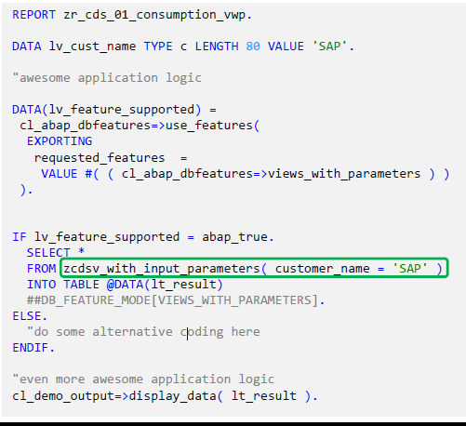
Consumption of CDS View
CDS View is consumed via OpenSQL using below 4 steps
Check if the feature is supported :abap_true
Provide (mandatory) input parameter(s) :Customer_name
Suppress syntax warning using the pragma ##
Provide a “fallback“ implementation / some error handling : ELSE

Slide 24
Summary
In this lesson, you have learnt:
Basic Concepts of Open SQL
Features of Open SQL
Open SQL Syntaxes and Statements
Performance Rules and Limitations of Open SQL
About Core Data Services
CDS in ABAP
Demos on CDS
CDS View Definition Features
Notes:
Add the notes here.
Add instructor notes here.

Slide 25
Review Questions
OPEN SQL Statements are those statements which are used to -------- or --------- database table data.
For OPEN SQL statements insertion in database table is possible in --------- way/ways.
Open SQL in ABAP application server is the ------- ---------layer calling an SQL like syntax.

